Slide 1
BB2950 Day 16: Monday 11-20-17
Learning objectives:
Explain why telomeres shorten during DNA replication, and how telomerase prevents this.
Explain how mismatches and damaged bases cause point mutations and other types of mutations.
Describe some of the common causes of mismatches and DNA damage.
Describe some of the common types of DNA damage.

Slide 2
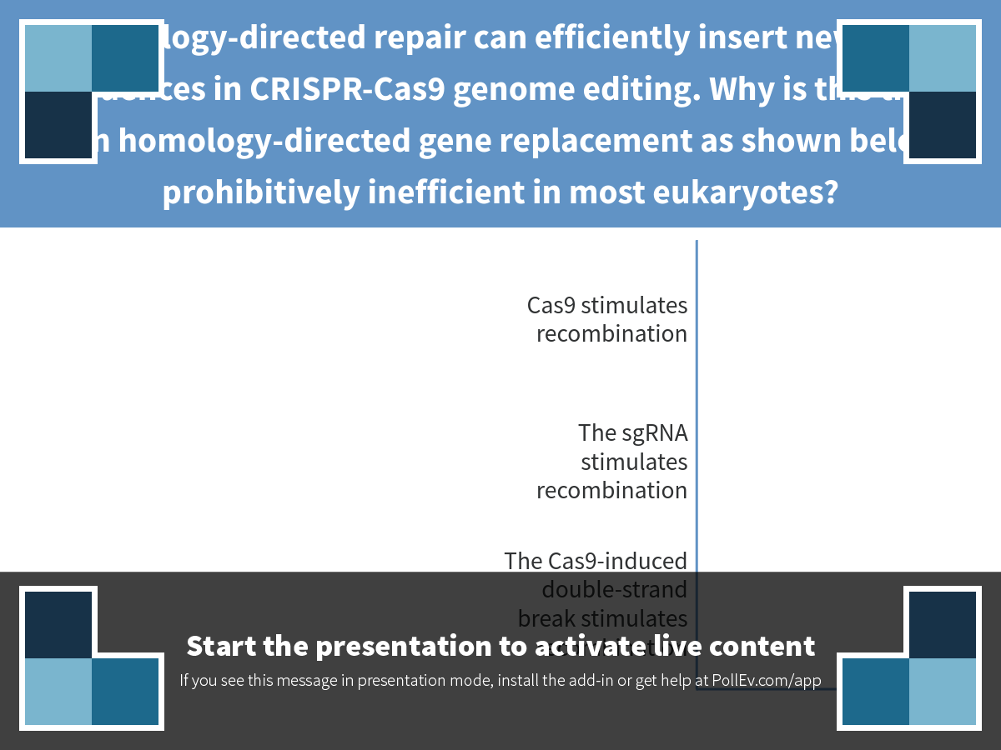
Notes:
Homology-directed repair can efficiently insert new DNA sequences in CRISPR-Cas9 genome editing. Why is this true, when homology-directed gene replacement as shown below is prohibitively inefficient in most eukaryotes?
https://www.polleverywhere.com/multiple_choice_polls/KZccWXt471fMvZo

Slide 3
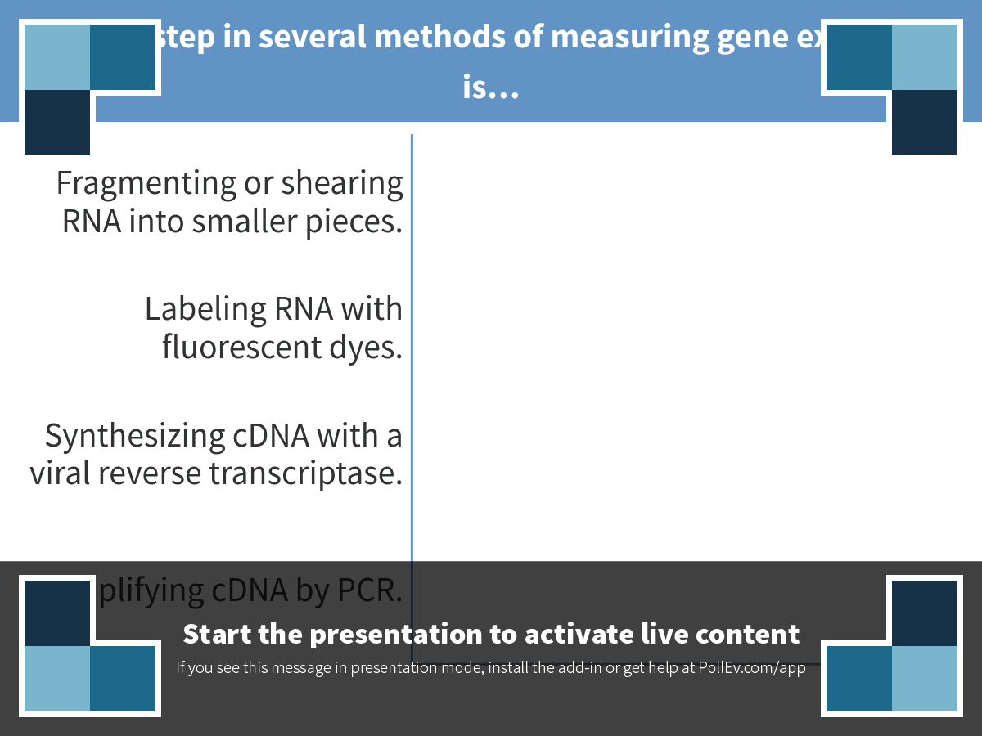
Notes:
An early step in several methods of measuring gene expression is…
https://www.polleverywhere.com/multiple_choice_polls/IYjkceNLdo2q6Dc

Slide 4
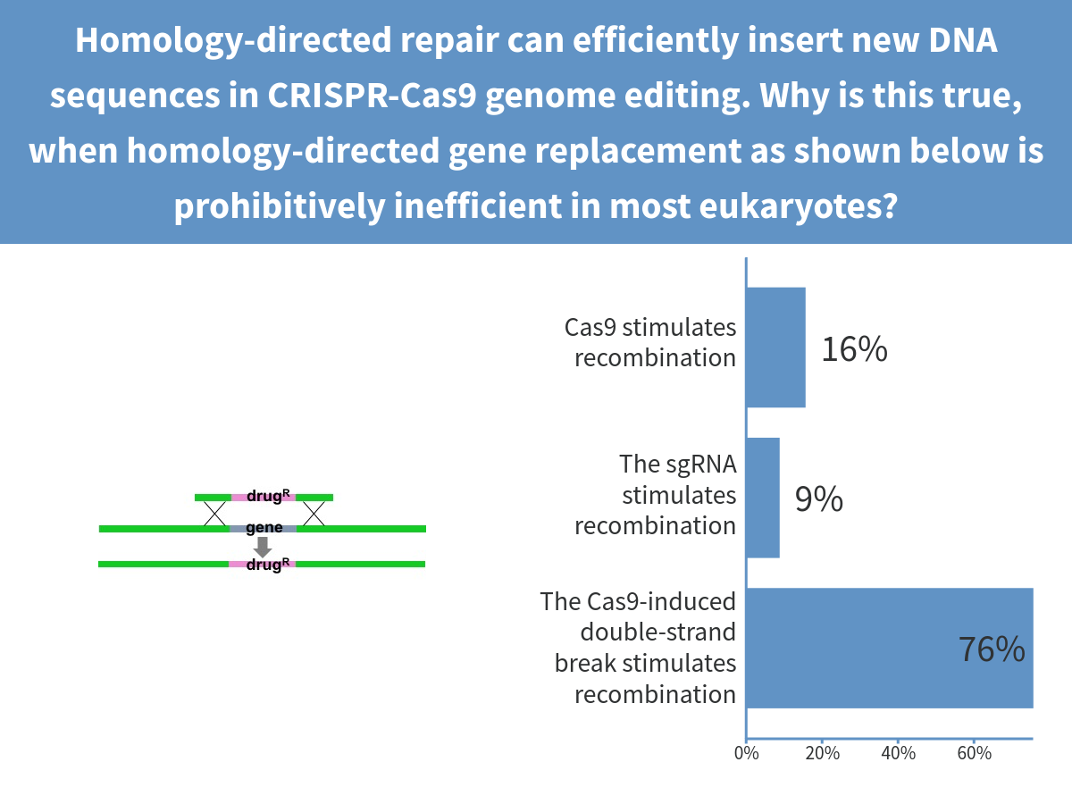
Notes:
Homology-directed repair can efficiently insert new DNA sequences in CRISPR-Cas9 genome editing. Why is this true, when homology-directed gene replacement as shown below is prohibitively inefficient in most eukaryotes?

Slide 5
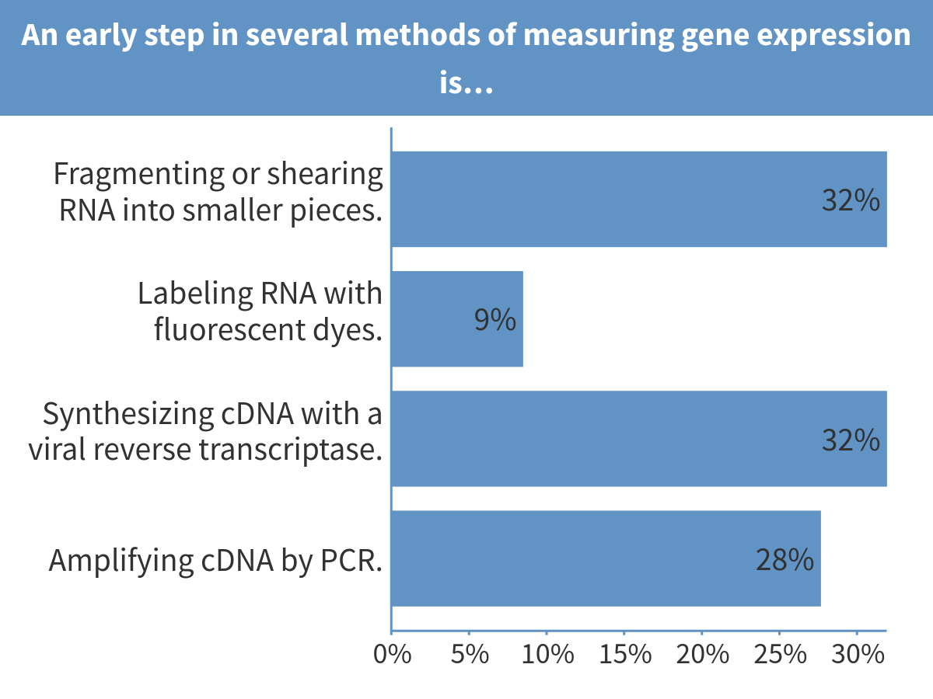
Notes:
An early step in several methods of measuring gene expression is…

Slide 6
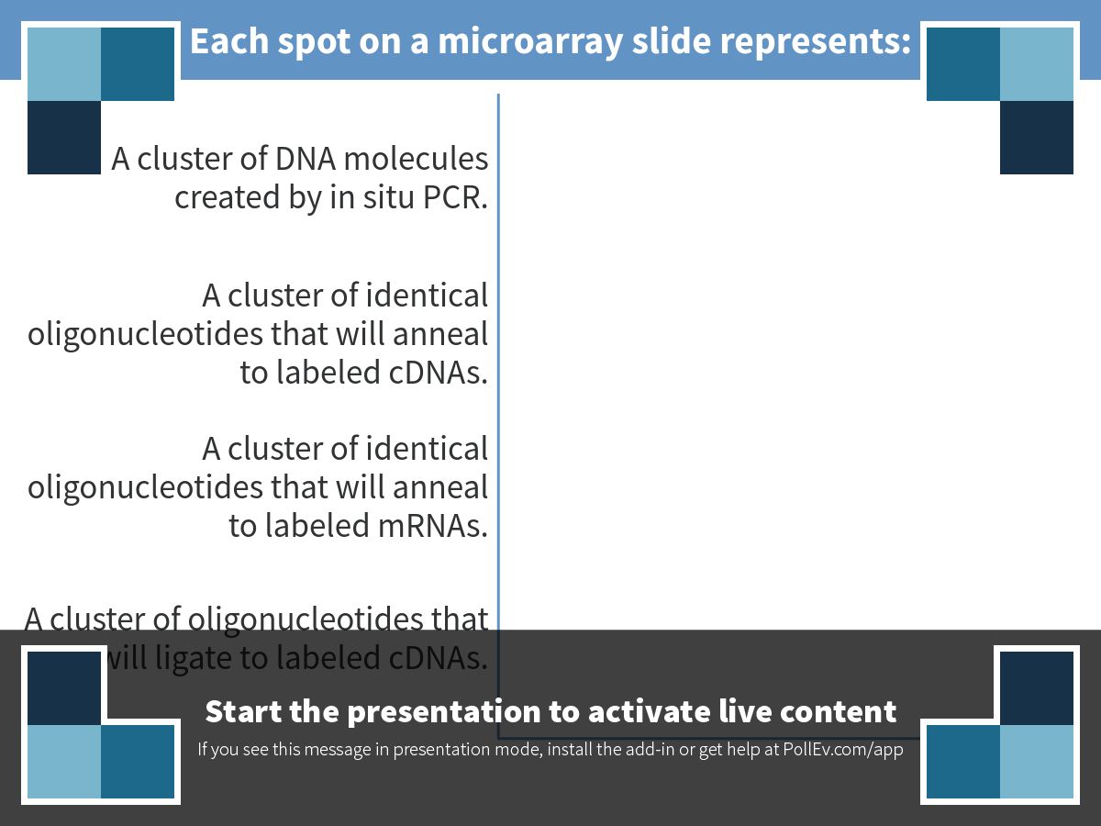
Notes:
Each spot on a microarray slide represents:
https://www.polleverywhere.com/multiple_choice_polls/CqHGhfYRXzQuXnp

Slide 7
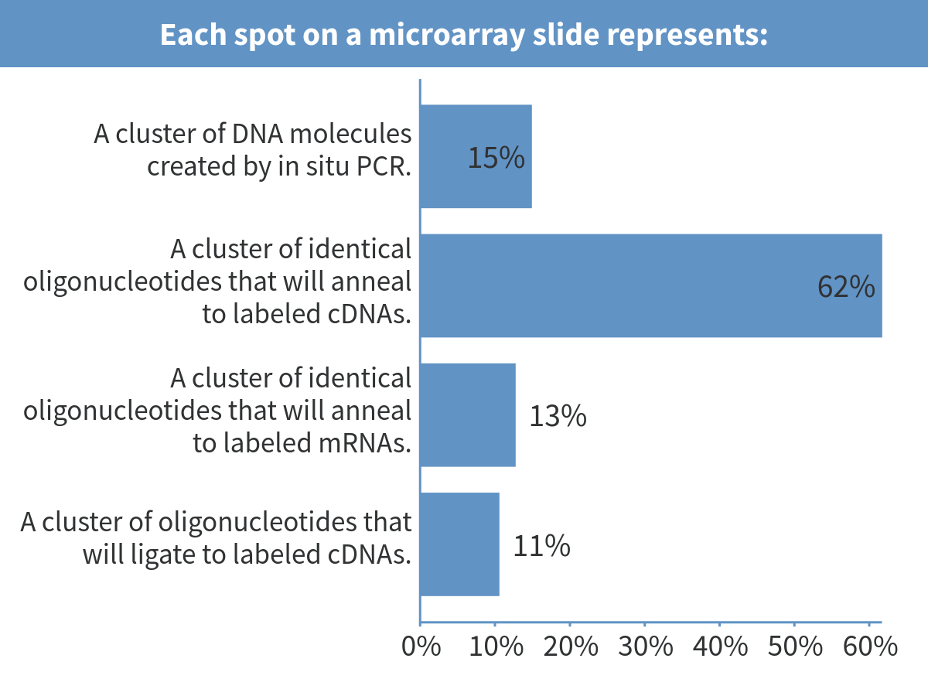
Notes:
Each spot on a microarray slide represents:

Slide 8
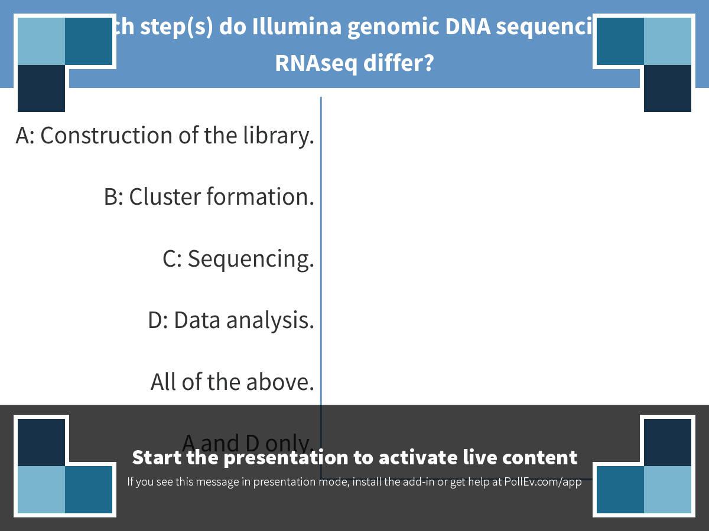
Notes:
In which step(s) do Illumina genomic DNA sequencing and RNAseq differ?
https://www.polleverywhere.com/multiple_choice_polls/dnpwaOVmv9KmUFB

Slide 9
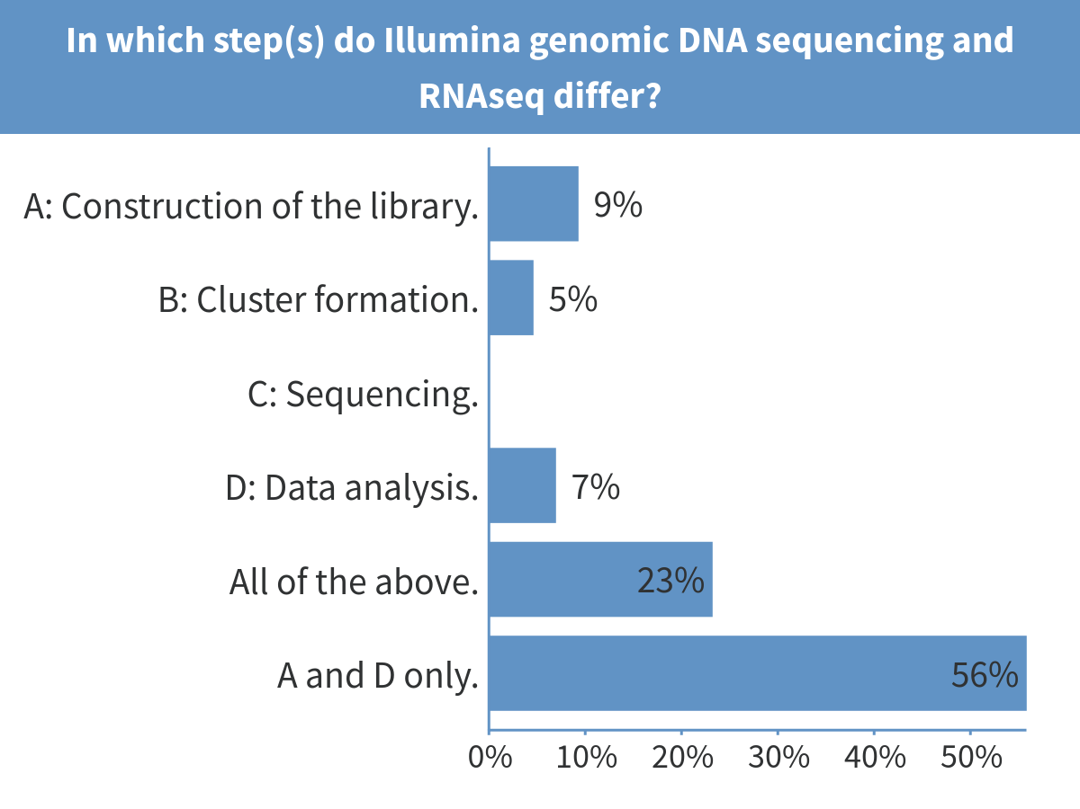
Notes:
In which step(s) do Illumina genomic DNA sequencing and RNAseq differ?

Slide 10
Terminating replication
Circular prokaryotic chromosomes: replication forks collide and fall apart, gaps are filled in and nicks ligated together.
Linear eukaryotic chromosomes: forks collide or run off ends. In some organisms and cell types, telomerase prevents shortening of the chromosomes due to incomplete lagging strand synthesis.

Slide 11
Telomeres and telomerase: the problem with replicating the end of the lagging strand
5’ …gtgagtatcgaaccgcgcgccaccgccgacctcgtcgacga 3’
3’ …CACTCATAGCTTGGCG 5’

Slide 12
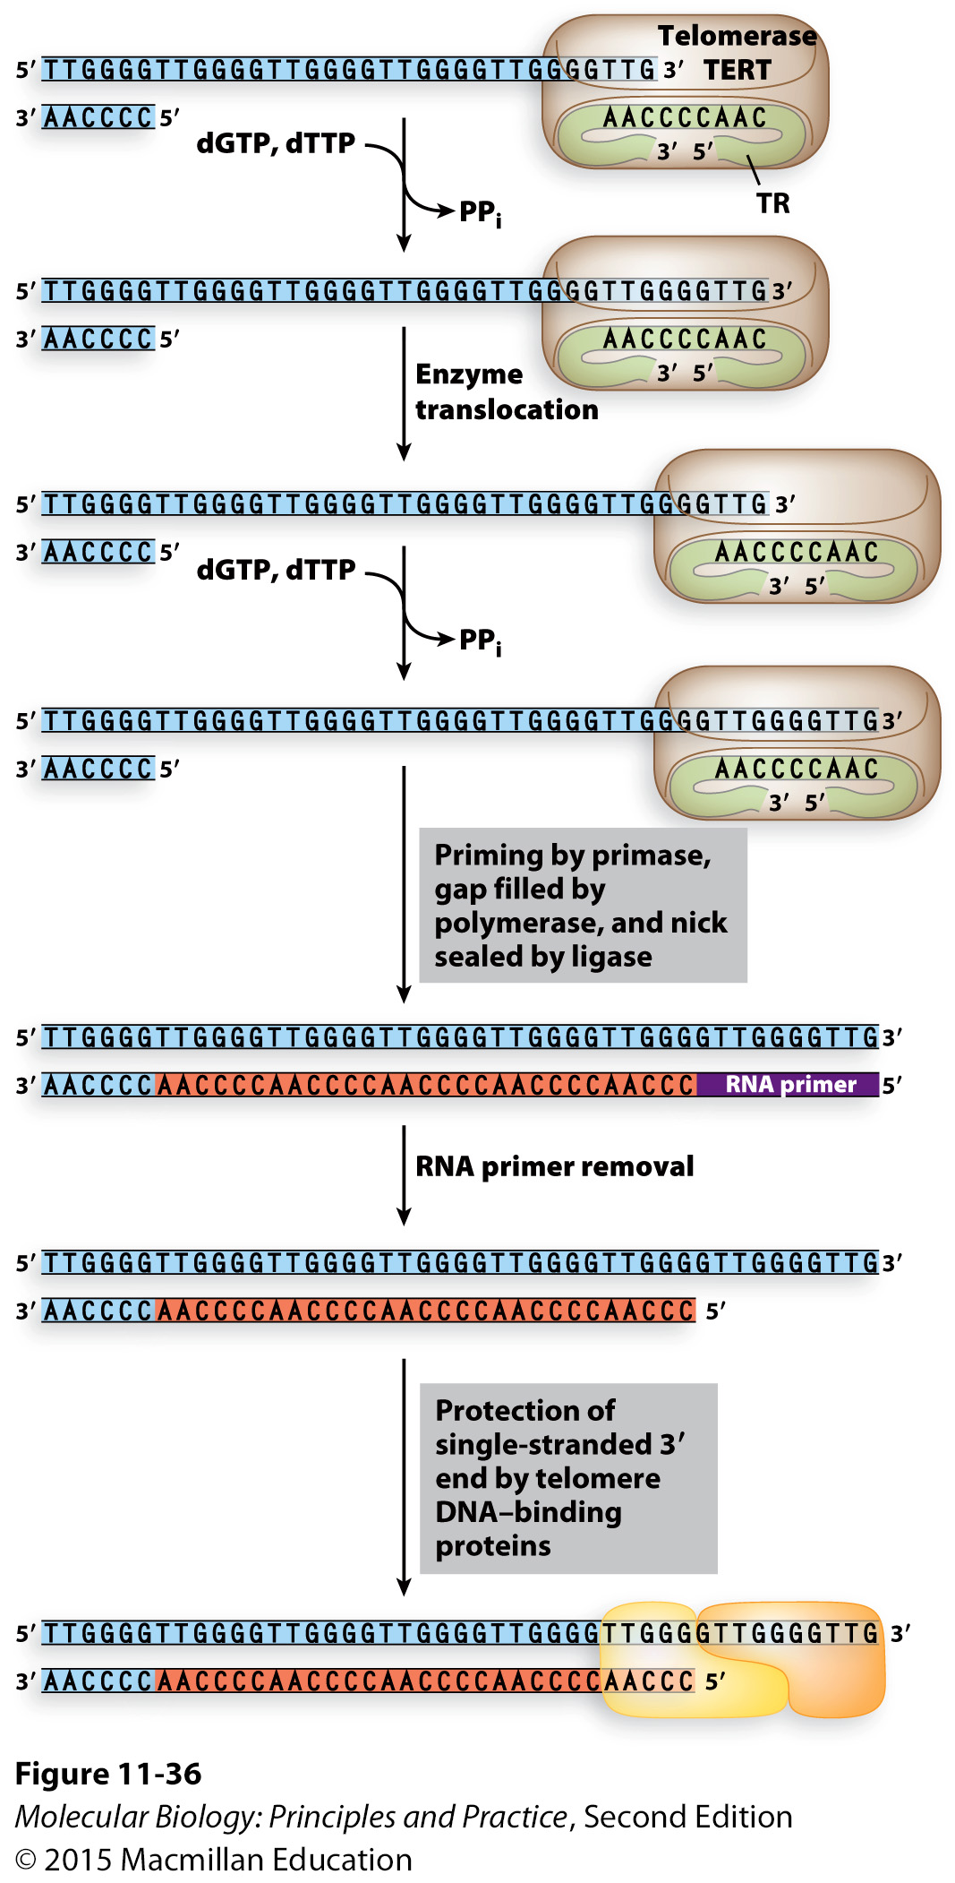
Telomerase uses an RNA template to extend the ends of chromosomes

Slide 13
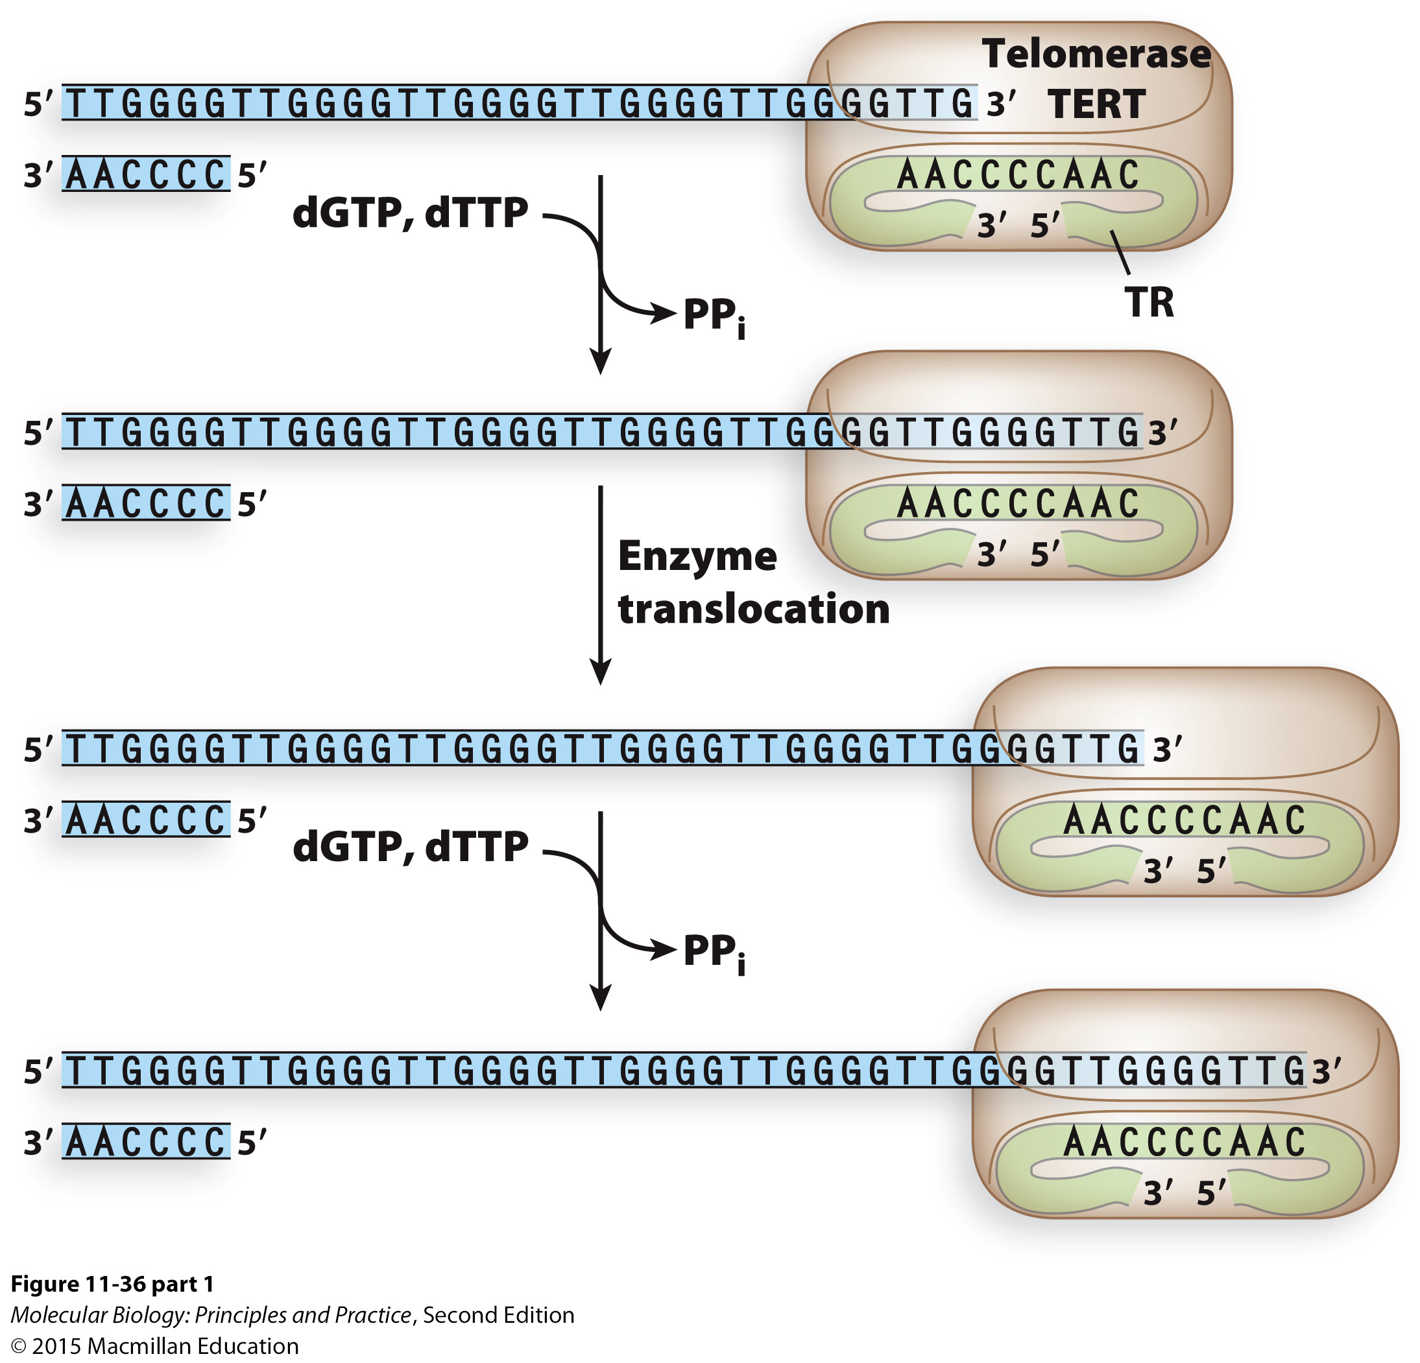
Notes:
Point out that telomerase is a protein-RNA complex

Slide 14
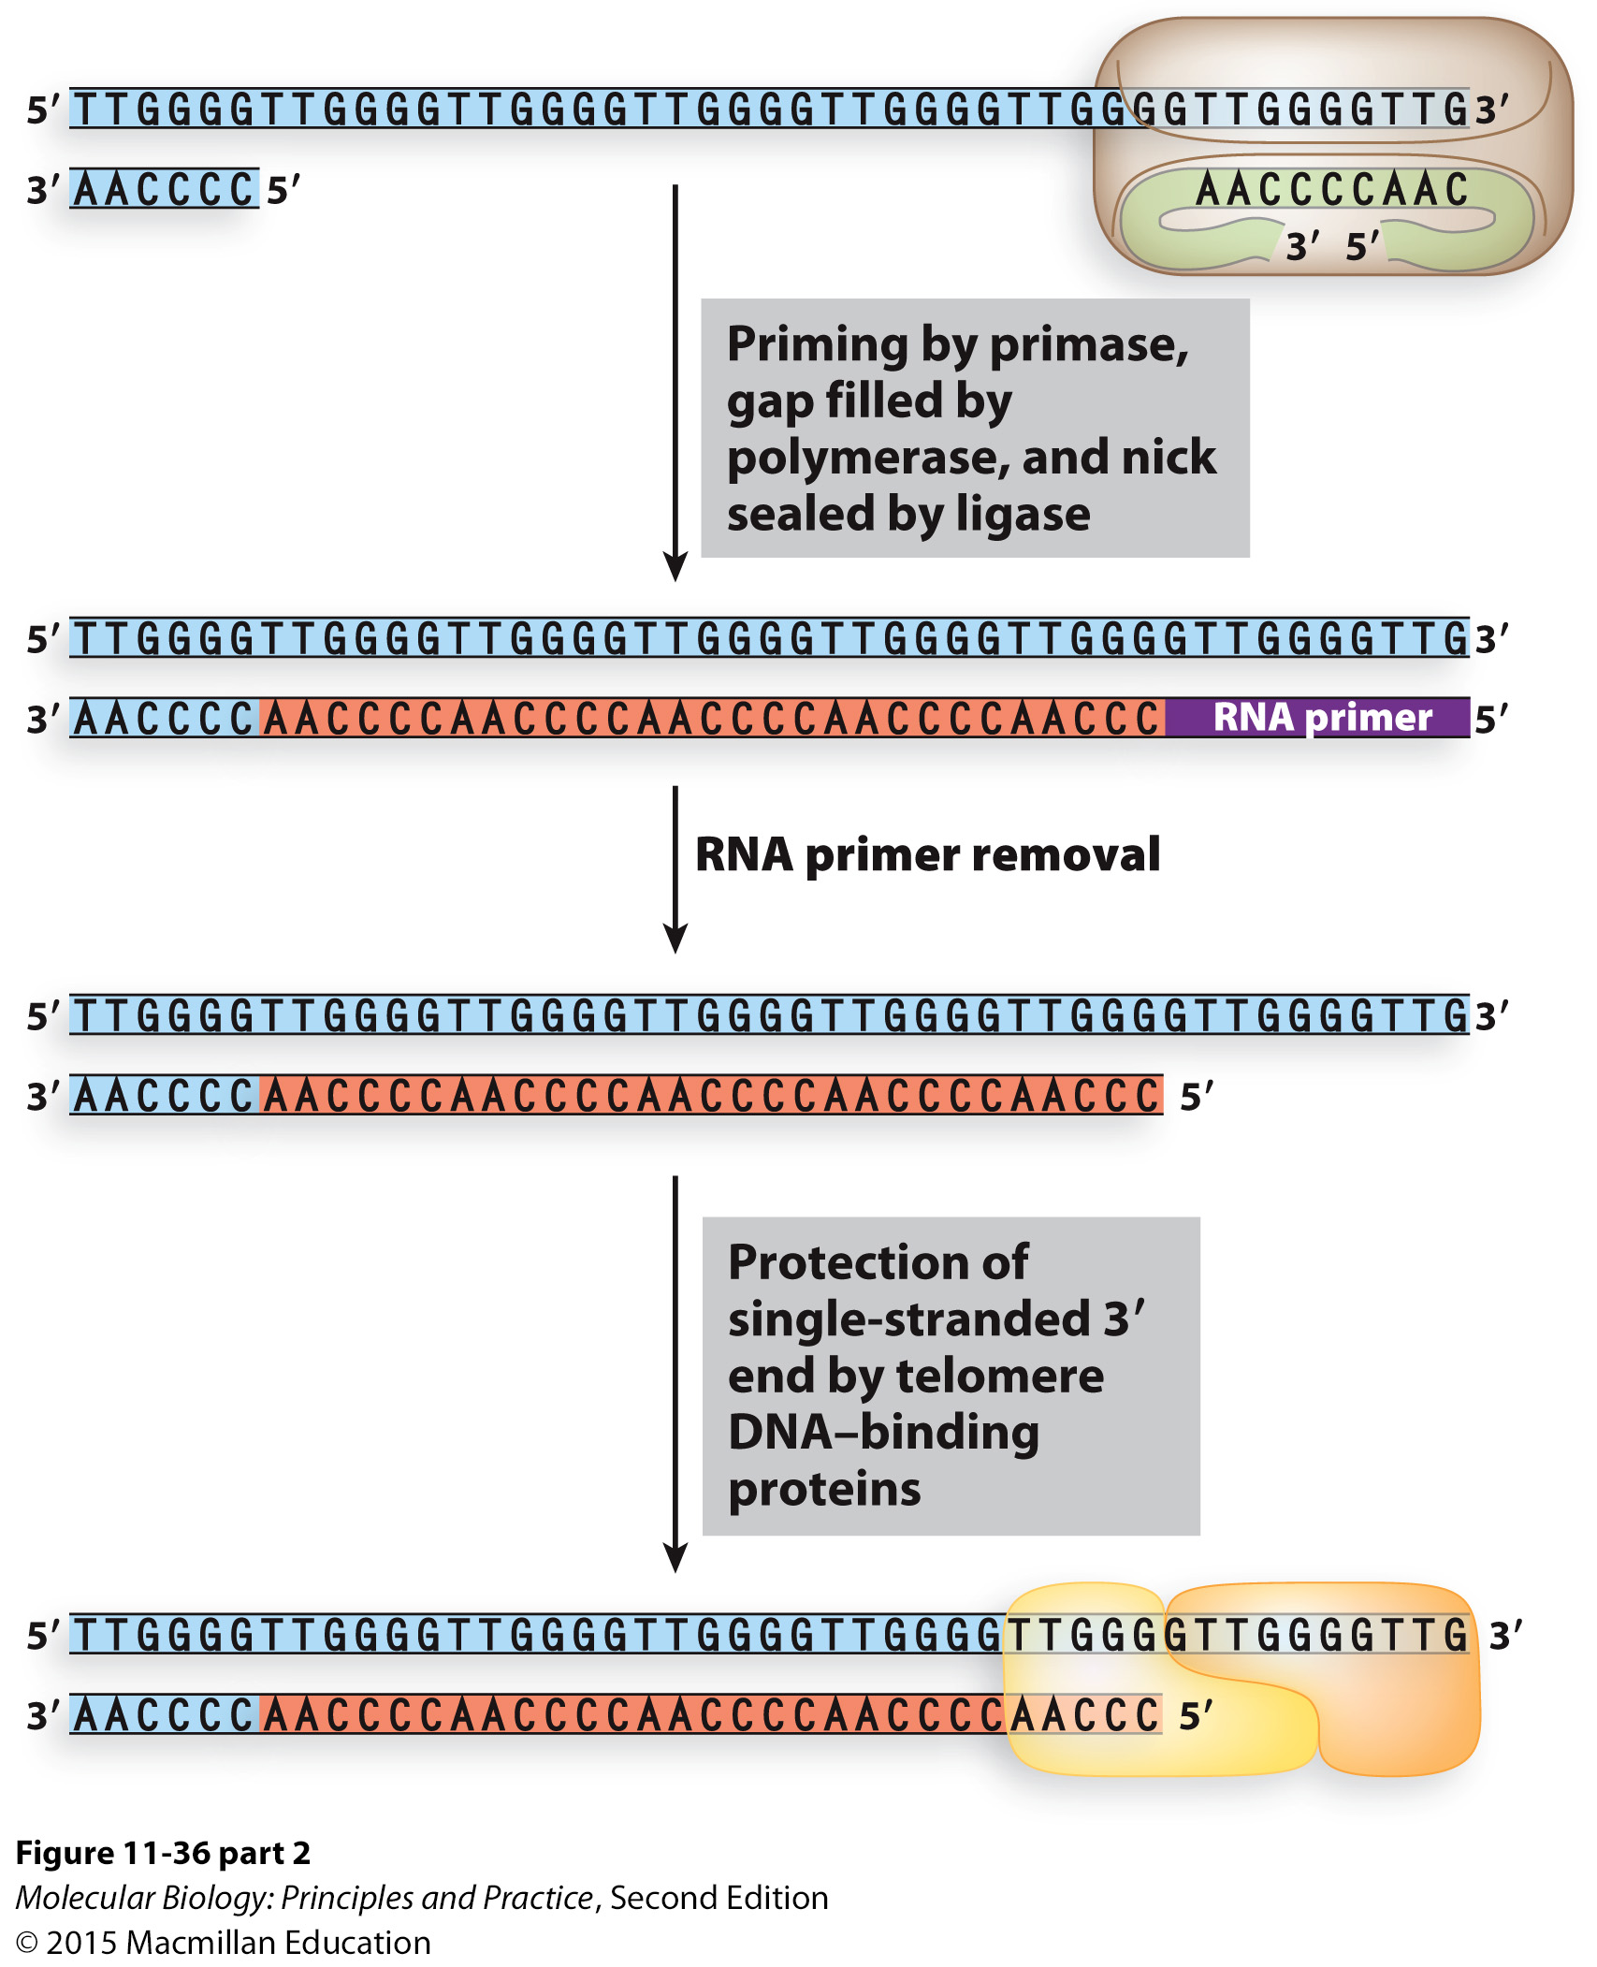

Slide 15
Key features of telomeres and telomerase
Telomerase doesn’t directly extend the lagging strand. It extends the strand that will be a template for lagging strand synthesis.
Telomerase is not active in most mammalian somatic cells.
Active in stem cells and most cancers
The ends of telomeres are coated in proteins most of the time. WHY?

Slide 16
DNA damage, mutations, and repair

Slide 17
Polymerase errors can lead to mutations
Proofreading is imperfect
Misincorporated nts can lead to point mutations
Notes:
Note which of these lead to point mutations, which lead to replication fork stalling, strand breaks, etc.

Slide 18
Polymerase errors can lead to mutations
Polymerase slippage can lead to indels (insertions/deletions)
5’GCAAAATT…3’
3’CGTTTTAA…5’
Notes:
Note which of these lead to point mutations, which lead to replication fork stalling, strand breaks, etc.

Slide 19
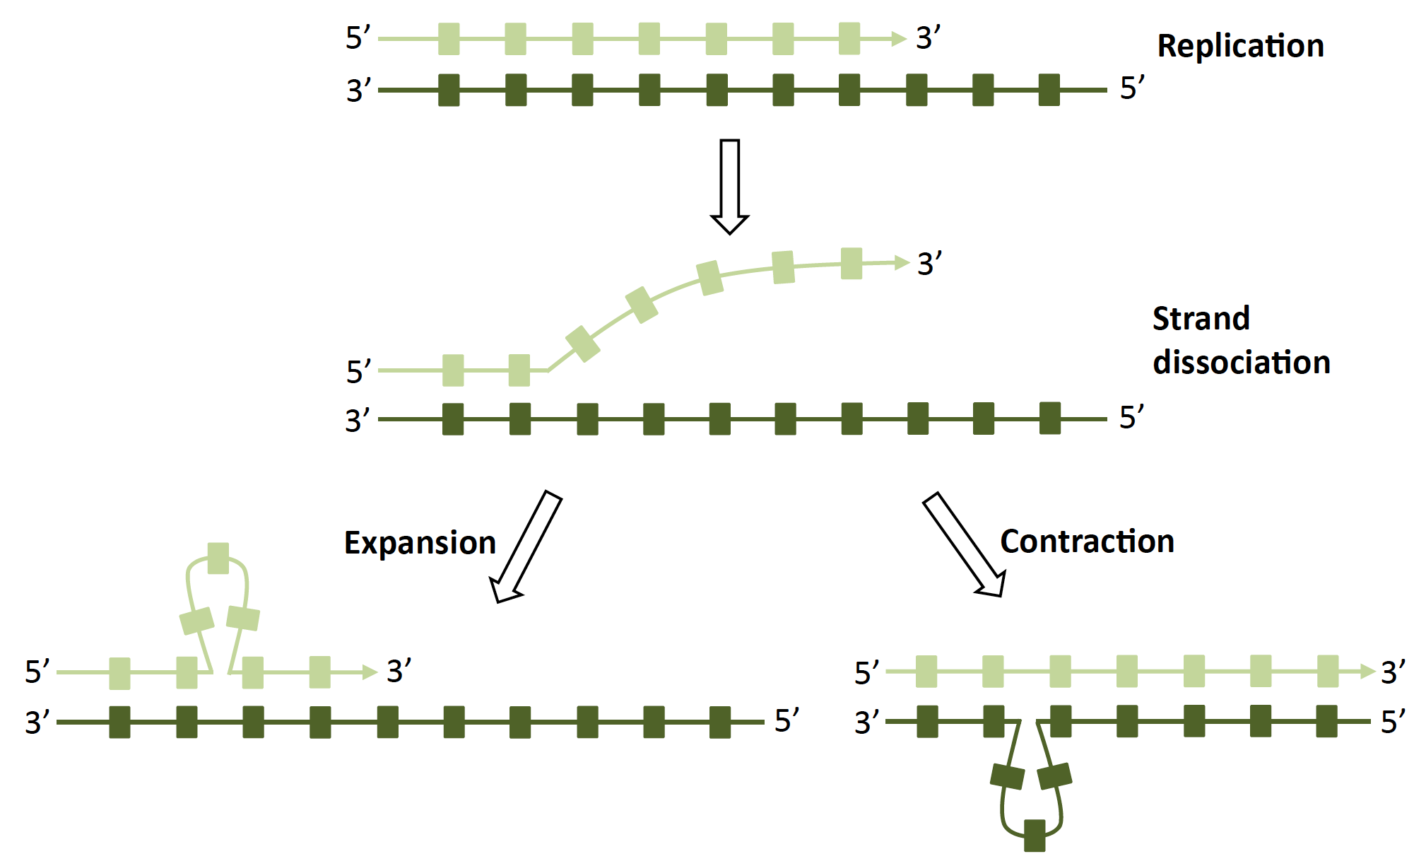
Polymerase slippage at repeat tracts leads to insertions and deletions
Example: trinucleotide repeat expansion causes Huntington’s disease.
Zhou et al. (2014). FEMS Microbiology Reviews, 38(1), 119–141.

Slide 20
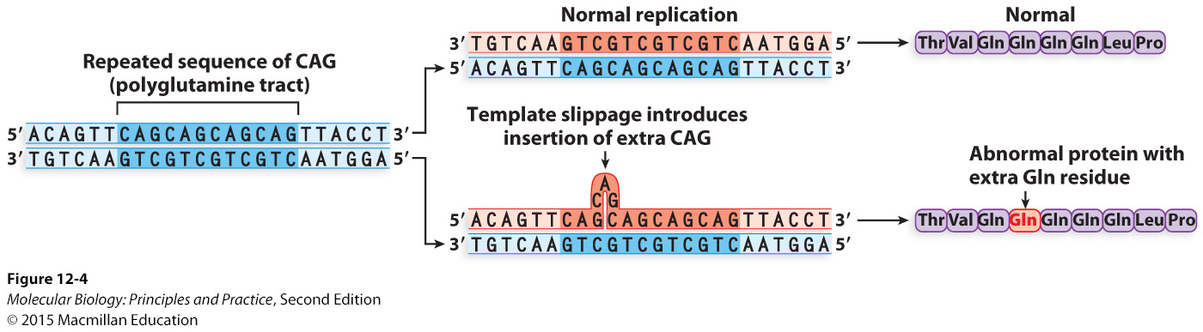
Trinucleotide repeat expansion occurs in multiples of 3 nts and does NOT affect the reading frame

Slide 21
Polymerase errors and DNA damage only cause mutations when they are not repaired correctly
Notes:
Mistakes/damage produce two outcomes: high-fidelity repair or no repair/low fidelity repair. Latter leads to mutations or cell death.

Slide 22
Some common causes of mismatches and DNA damage
Polymerase errors
Spontaneous hydrolysis
Cytosine deamination
Loss of base
Notes:
Note which of these lead to point mutations, which lead to replication fork stalling, strand breaks, etc.

Slide 23
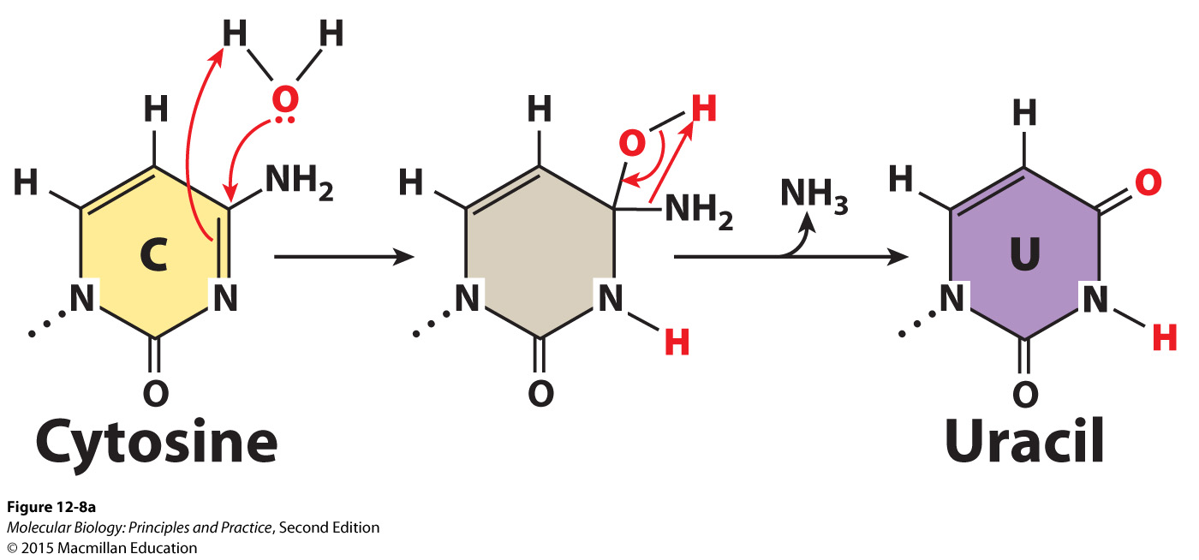
Spontaneous deamination converts cytosine into uracil
What will happen during DNA replication if the uracil is left in the DNA?

